Slide 1
Investiture ceremony

Slide 2
INTRODUCTION And Meaning
WHAT,WHERE,WHEN, WHO,HOW
OATH
SUMMARY
QUESTIONS

Slide 3

introduction
Investiture ceremony definition: An investiture is a ceremony in which someone is given an official title.
An occasion where a school entrusts its upcoming leaders with certain roles and responsibilities.
Wherein all the young students are well prepared to don the mantle of leadership and responsibility while carrying a title “Cyber Ambassador”.
It is a platform to showcase the leadership skills and abilities of the students .

Slide 4

How do you conduct an investiture ceremony in school?
1. Introduction. 2. Lighting the lamp. 3. Prayer. 4. Welcome speech. 5.Flag hoisting. 6. Leaders march. 7.Pinning of badges/Oath taking ceremony.(The principal ,teachers, in charges, SHE team officers, Cyber ambassadors )
8. Dance, skit, speech by the mentor teachers,Cyber ambassadors.

Slide 5
1.Oath taking and badge presentation in the presence of SHE team officers.
Address by SHE team officers.
2.Address by mentor teachers-briefing on objectives of CAP programme, how and when to approach SHE team officers.
3.Session by CA on I cyber safety, II cyber security,
and III cyber crimes.
4.Poster,pamphlet,slogan,skit presentation in both English and Telugu.
5.Material required:
Backdrop screens, flex banners, posters badges, stationery etc

Slide 6


Logos

Slide 7

Banner

Slide 8
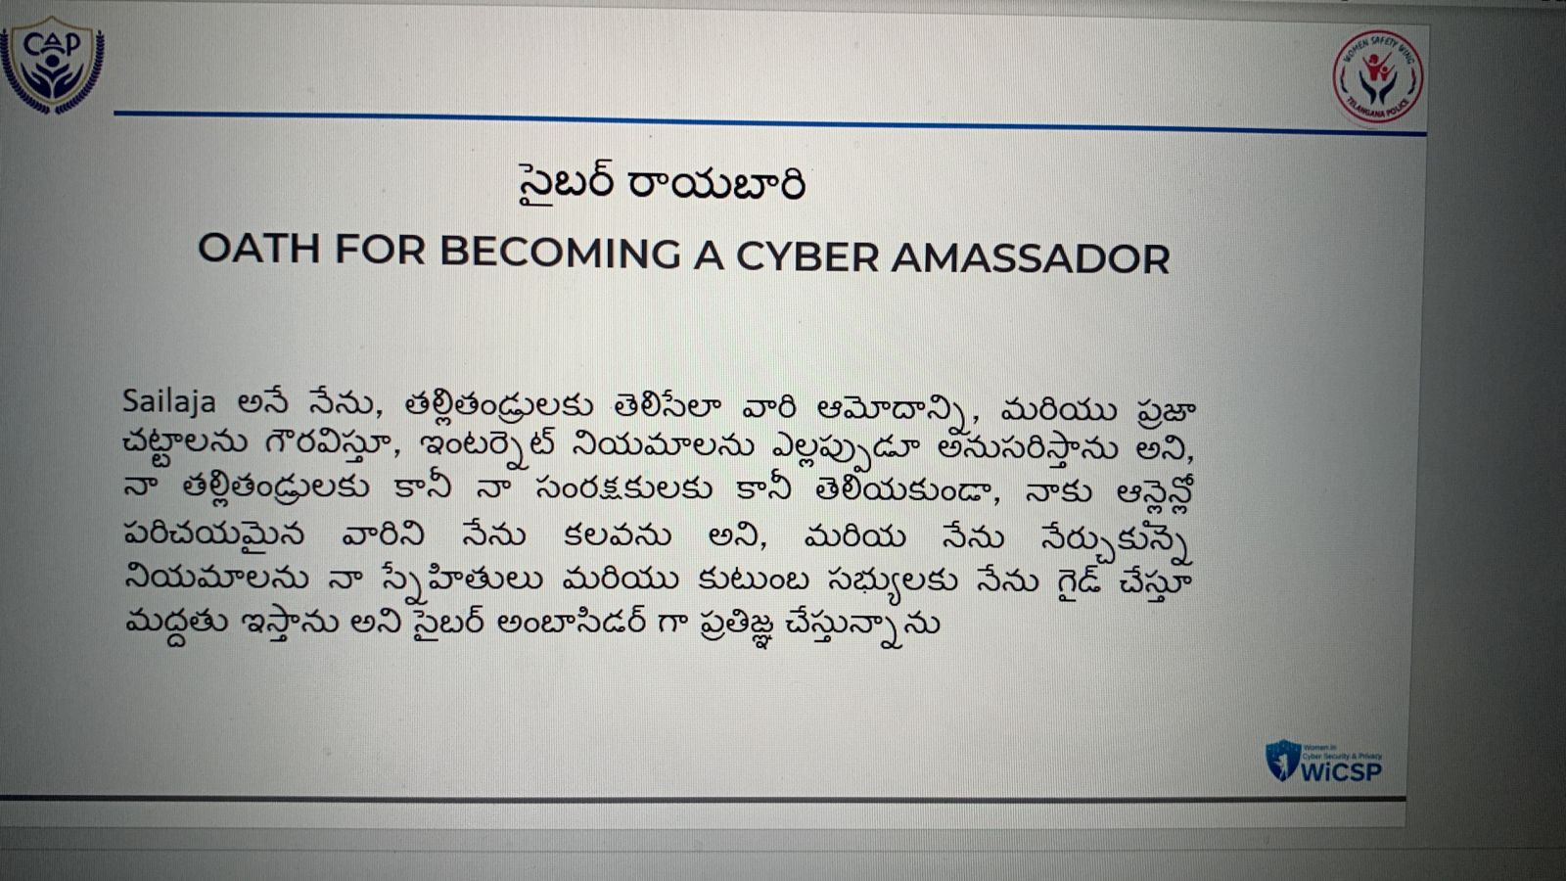
OATH IN TELUGU

Slide 9

OATH

Slide 10
thank you

Slide 11
Questions

